Slide 1


Road classification using Convolutional Neural Network (CNN) in Python
Arip Syaripudin Nur
L20583502
Department of Civil and Environmental Engineering

Slide 2
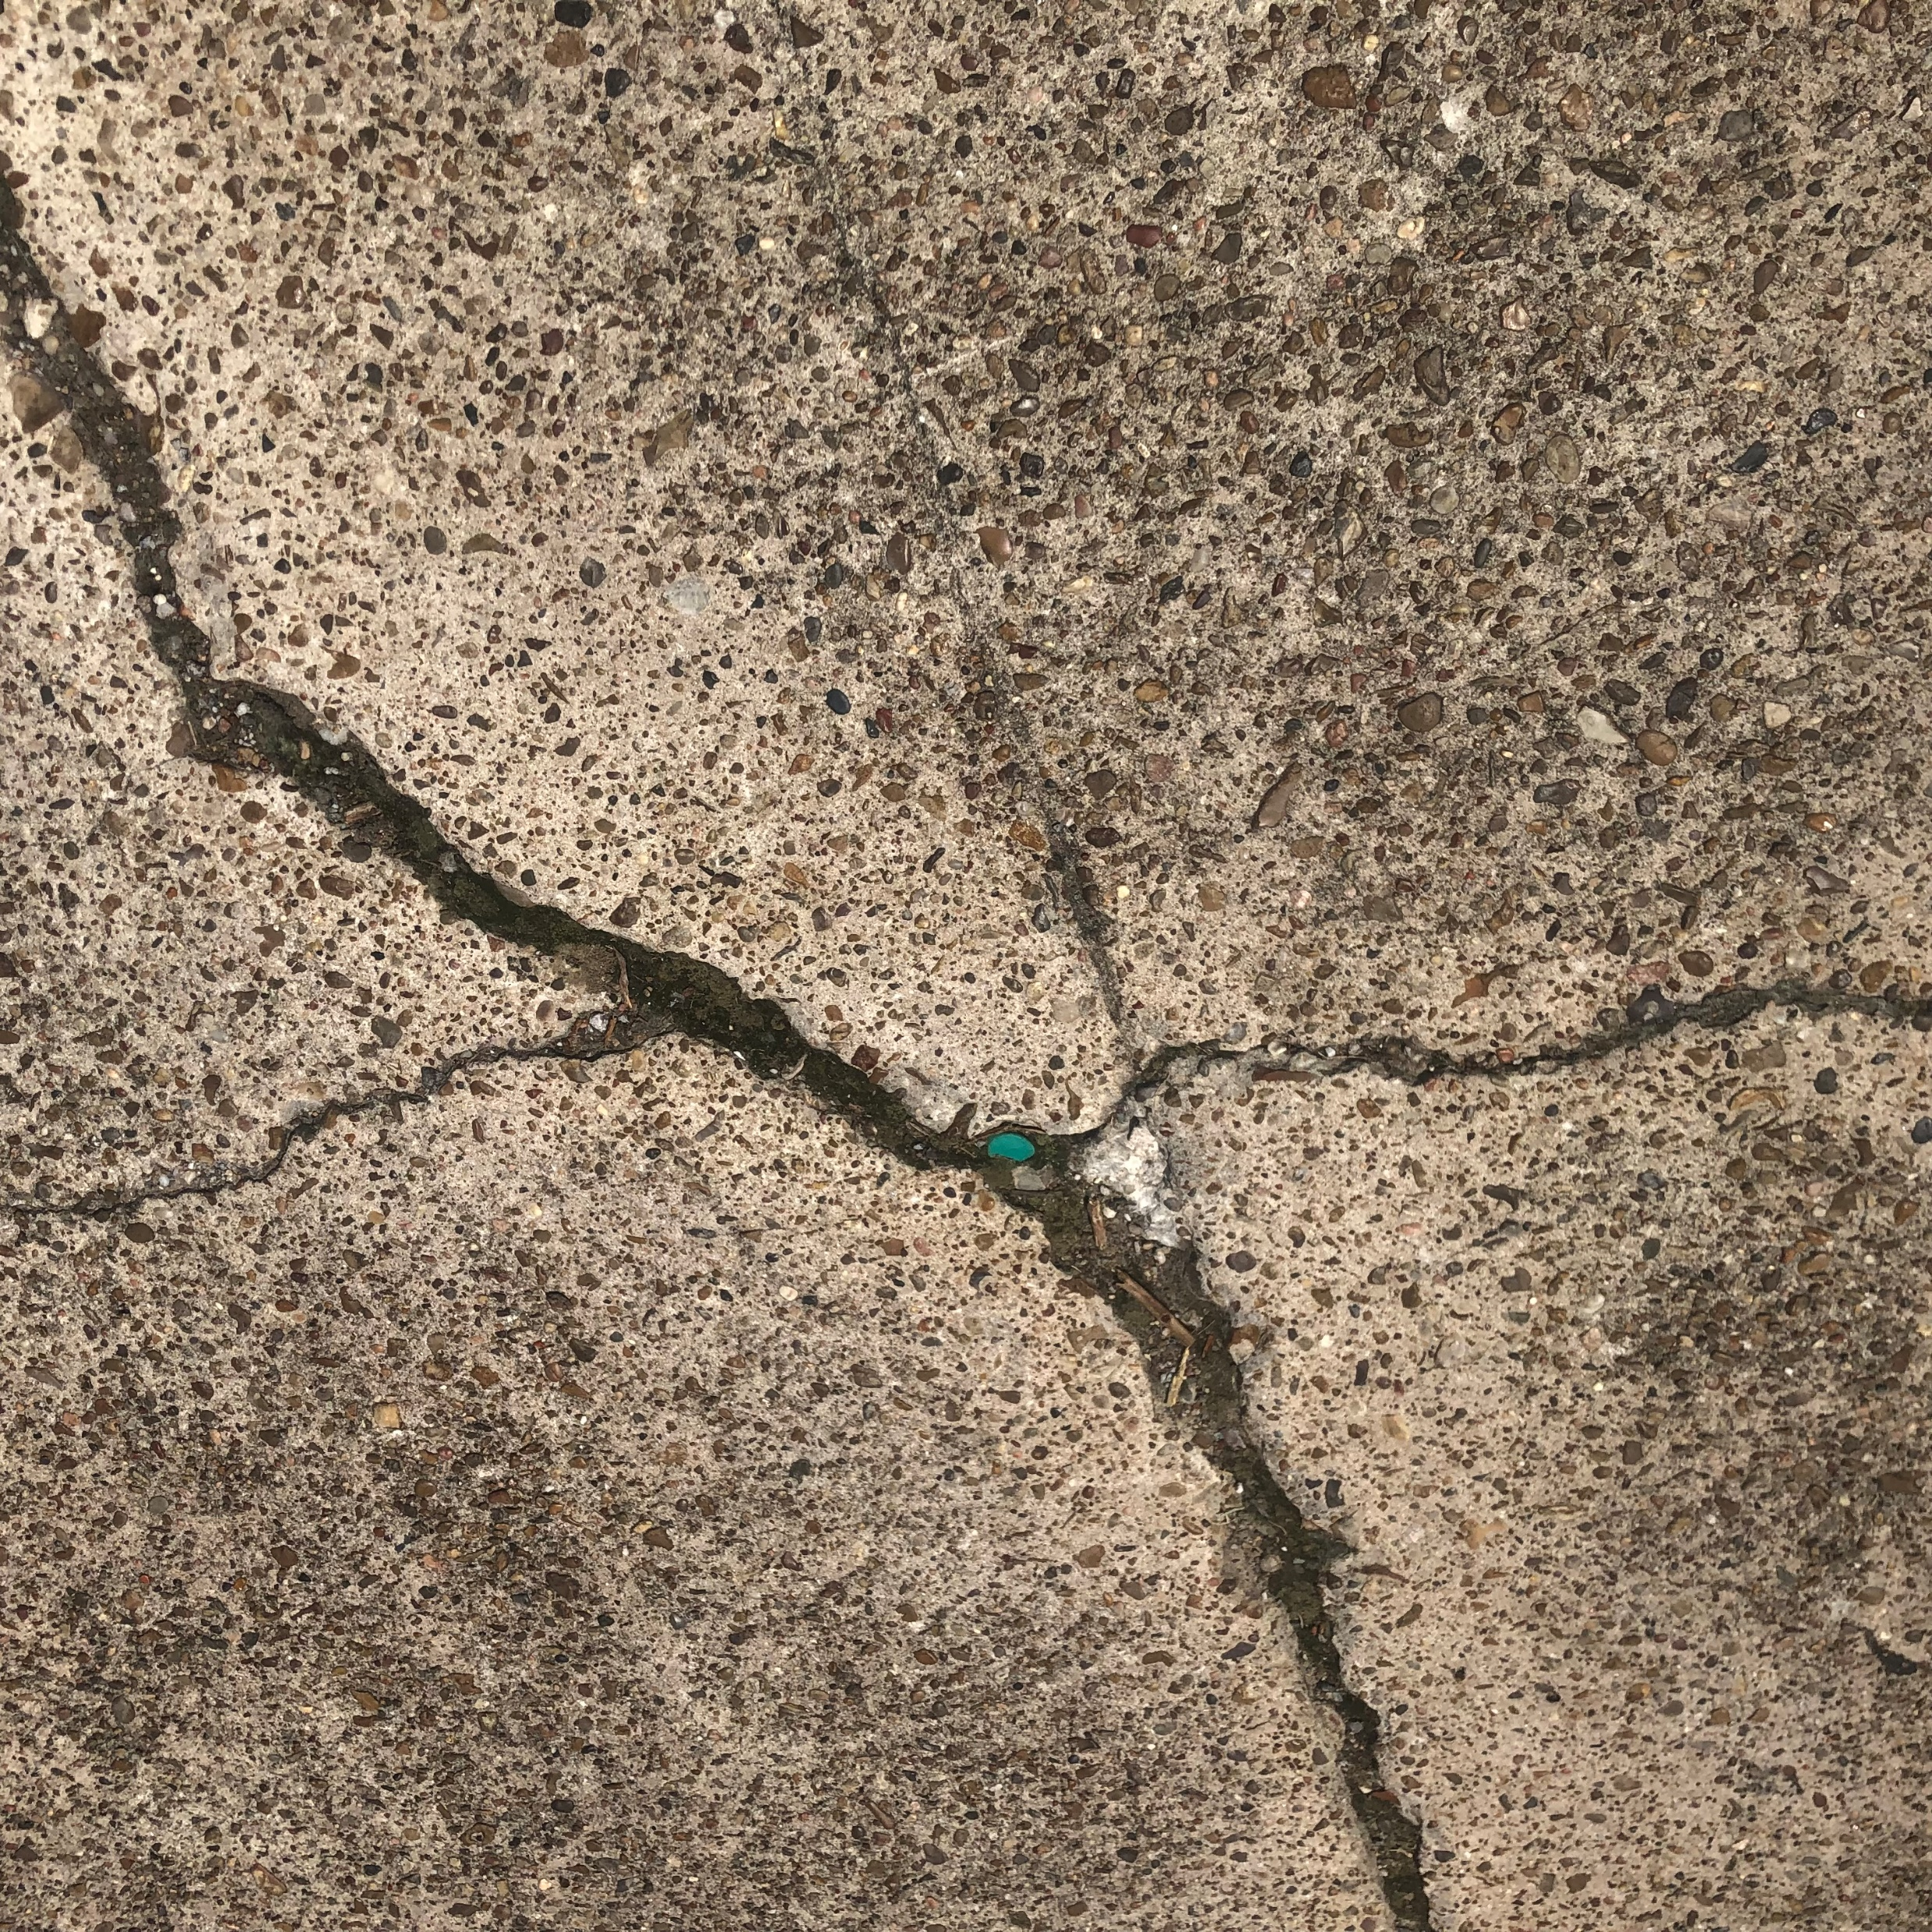
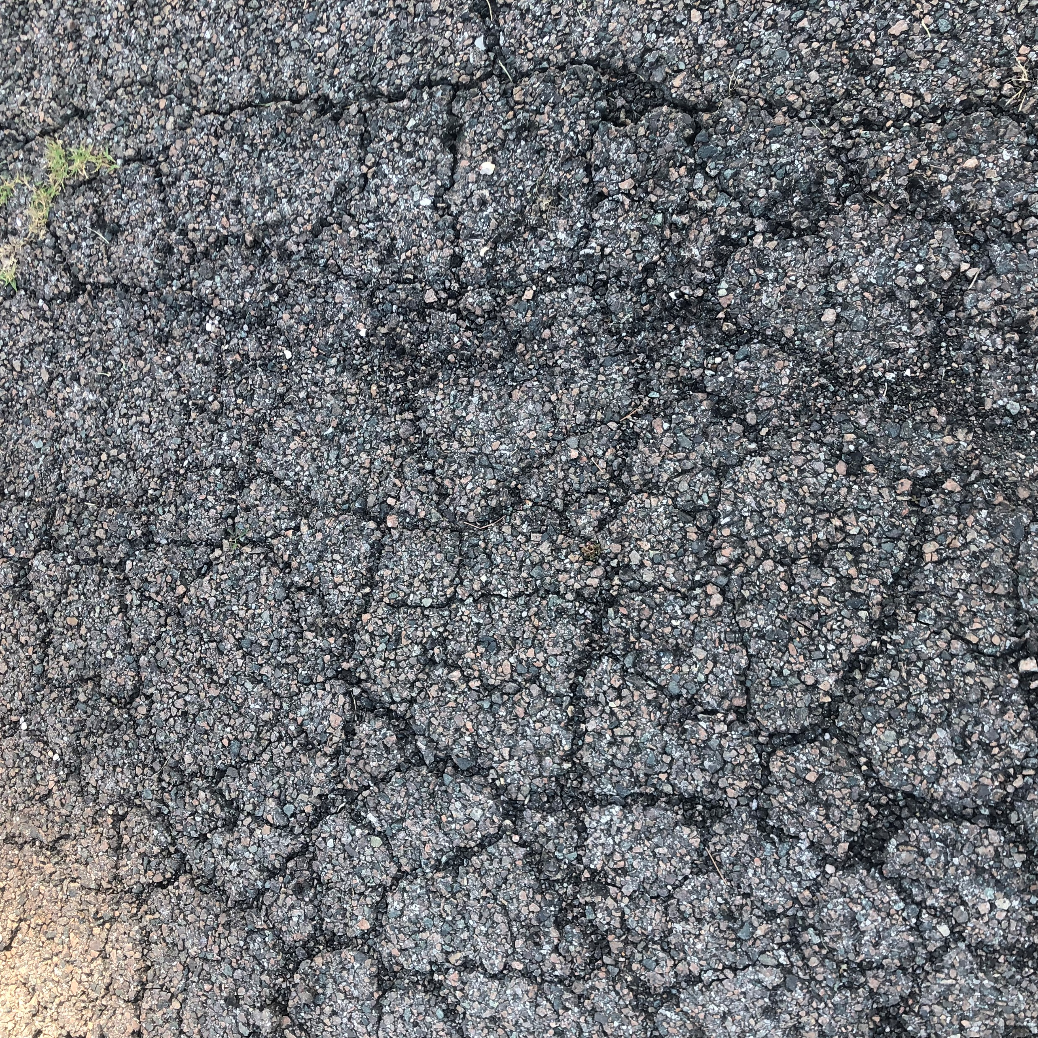
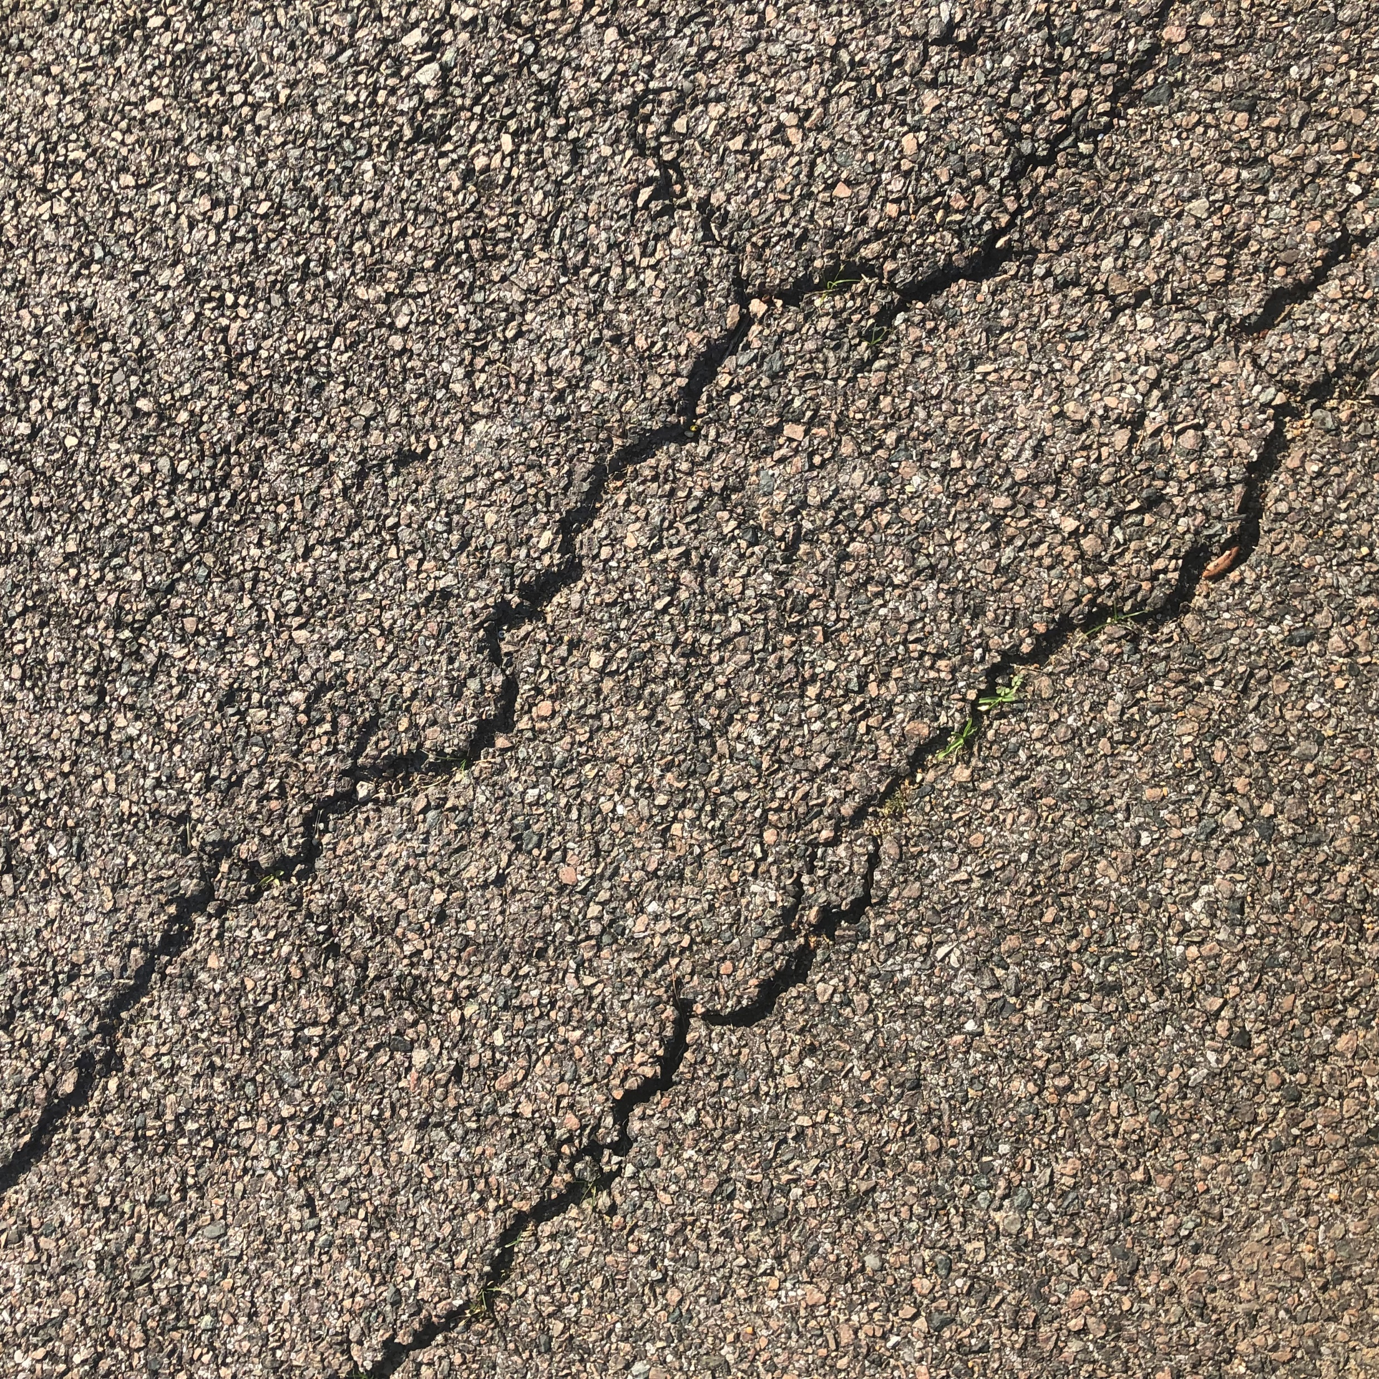



Datasets
1024 images of road have been collected using iPhone 8 using square mode.
Located at Lamar University.
Road with cracks
Road without cracks

Slide 3
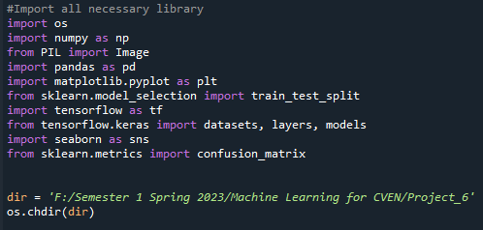
Import Library and set directory

Slide 4
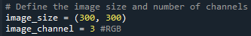
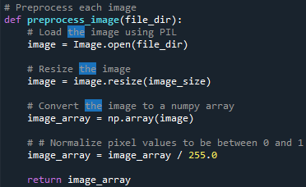
Image Preprocessing
Resize the images to 300,300
Normalize the pixel values to between 0 and 1

Slide 5
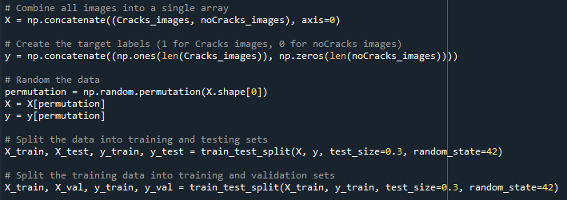
Image Preprocessing
Combine all images in 1 datasets
Give labels, 1 for Crack images and 0 for noCracks images
Split the dataset to Train, Val, and Test datasets.
Training data shape: (501, 300, 300, 3)
Validation data shape: (215, 300, 300, 3)
Testing data shape: (308, 300, 300, 3)

Slide 6
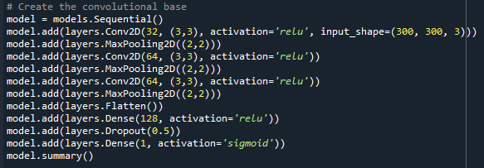
Create Architecture of the CNN model
Model: "sequential_1"
Layer (type) Output Shape Param #
conv2d_3 (Conv2D) (None, 298, 298, 32) 896
max_pooling2d_3 (MaxPooling2D) (None, 149, 149, 32) 0
conv2d_4 (Conv2D) (None, 147, 147, 64) 18496
max_pooling2d_4 (MaxPooling (None, 73, 73, 64) 0
conv2d_5 (Conv2D) (None, 71, 71, 64) 36928
max_pooling2d_5 (MaxPooling2D) (None, 35, 35, 64) 0
flatten_1 (Flatten) (None, 78400) 0
dense_2 (Dense) (None, 128) 10035328
dropout_1 (Dropout) (None, 128) 0
dense_3 (Dense) (None, 1) 129
=================================================================
Total params: 10,091,777
Trainable params: 10,091,777
https://www.tensorflow.org/tutorials/images/cnn

Slide 7
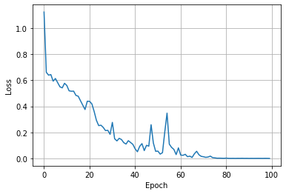
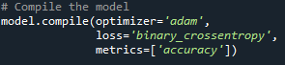
Compile and Train the model

Slide 8
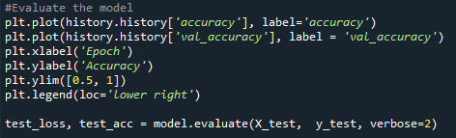
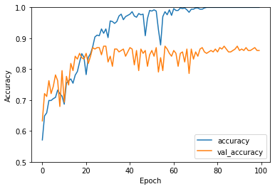
Model Evaluation
10/10 - 2s - loss: 1.1192 - accuracy: 0.8636 - 2s/epoch - 206ms/step

Slide 9
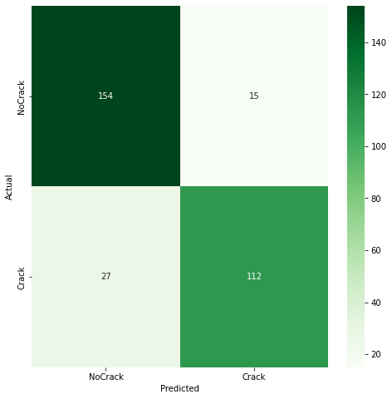
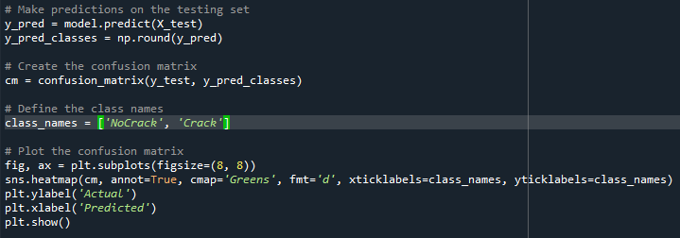
Model Evaluation
Testing data shape: (308, 300, 300, 3)

